Slide 1



HOTEL WEBSITE

Slide 2

ABOUT
US
私たちに関しては
1

Slide 3





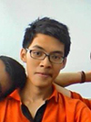


ABOUT US
Vu Tran Hoang
Team Member
Tran Ba Quyen
Team Member
Nguyen Viet Hung
Team Leader
- HOWE Team -
We are final year students of FPT University. With the tutorial of Mr.Phan Truong Lam,
we had successfully built this project
Dang Cong Son
Team Member
Dang Duc Manh
Team Member
2

Slide 4

Q & A - 質問と回答
Outlines
アウトライン
8
Demo - デモ
7
6
Lesson Learned
教訓
Software Testing
ソフトウェアテスト
5
Software Design Description
ソフトウェア 設計書
4
3
Software Requirement Specification
ソフトウェア要求仕様
2
Software Project Management
プロジェクト管理
1
Background バックグラウンド
3

Slide 5
BACKGROUND
バックグラウンド
4

Slide 6
Background
バックグラウンド
First 3 months of 2017:
The total number of tourists to Quangninh was about 3,769 million people, up 12% over the same period of 2016.
The number of tourists to Halong Bay was about 928,900 people.
The higher the number of tourists is, the greater the demand for accommodation and hotel services increases, resulting in the establishment of more hotels.
Hotels face with difficulties in:
Booking.
Room services managing.
Using tools for management.
5

Slide 7

Background
バックグラウンド
Idea
Develop a website to:
Brand the hotel’s image.
Offer customers with a time-saving and efficient booking way
Provide favorable tool for the hotel’s staffs.
6

Slide 8
PROJECT MANAGEMENT
プロジェクト管理
7

Slide 9
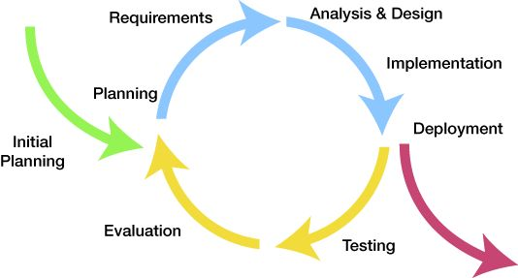
Project Management
プロジェクト管理
Software development process
ソフトウェア開発のプロセス
Iteration 1: May 08th – Jul 21st
Iteration 2: Jul 24th – Aug 25th
Iterative Model
8

Slide 10
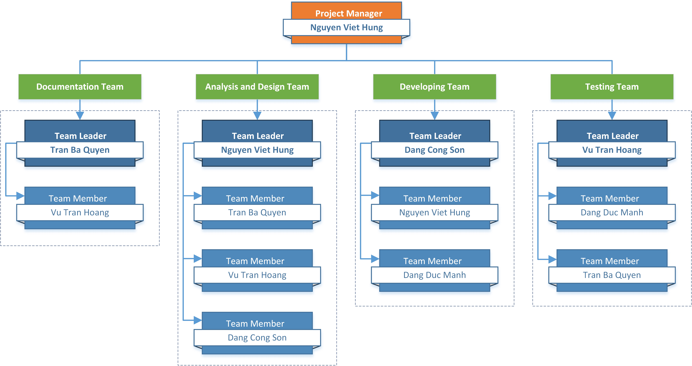
Project Management
プロジェクト管理
Organizational Structure - 組織構造
9

Slide 11
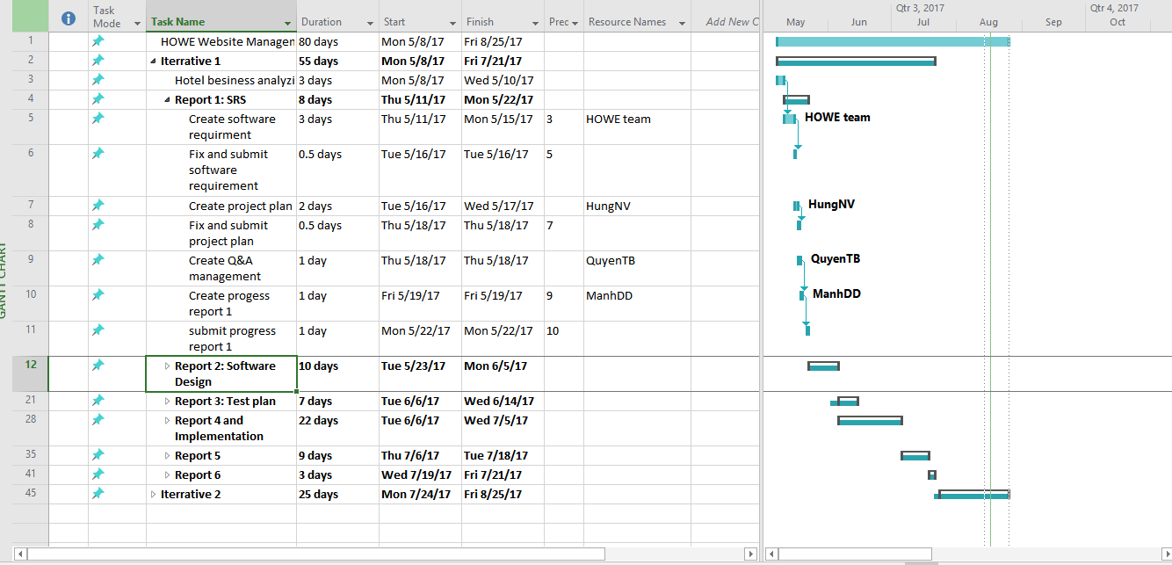
Project Management
プロジェクト管理
Project schedule - プロジェクトスケジュール
10

Slide 12





Project Management
プロジェクト管理
Tools & Infrastructure ツールと インフラストラクチャ
Tools for project management
11

Slide 13








Project Management
プロジェクト管理
Project Infrastructure - プロジェクトインフラストラクチャ
Tools for developing
12

Slide 14
Project Management
プロジェクト管理
Risk Management - リスク管理
No | Name | Root Cause | Probability | Avoidance plan | Contingency plan | Impact
1 | Project team don’t meet the deadline on time. | Members lack of responsibility Lack of management. | Medium | Make rules and penalties for member who didn’t meet the deadline. | Working overtime to complete tasks on time. | High
2 | Requirement changed while project is being processed. | SRS is not provide all information about user requirement such as: lack of customer’s requirement, misunderstand customer’s requirement. | High | SRS should be reviewed carefully by PM and Supervisor. Always do brainstorming carefully to design detail system. Hold all meeting and make minimize effort to change and improve design by requirement changes. | Team members will have meetings with supervisor to analyze the requirement changes, and make a specific action to resolve that problem. | High
13

Slide 15






Project Management
プロジェクト管理
Communication management - コミュニケーション管理
Time: 4 ~7 hours/day, 5 days/week.
Location: P505L Alpha building, room
Communication:
Meeting minutes:
14

Slide 16

SOFTWARE REQUIREMENT SPECIFICATION
ソフトウェア要件仕様
15

Slide 17




Software requirement specification
ソフトウェア要件仕様
27 use cases
10 use cases
8 use cases
Manager
Receptionist
Common
5 use cases
3 use cases
1 use case
Guest
Accountant
16

Slide 18
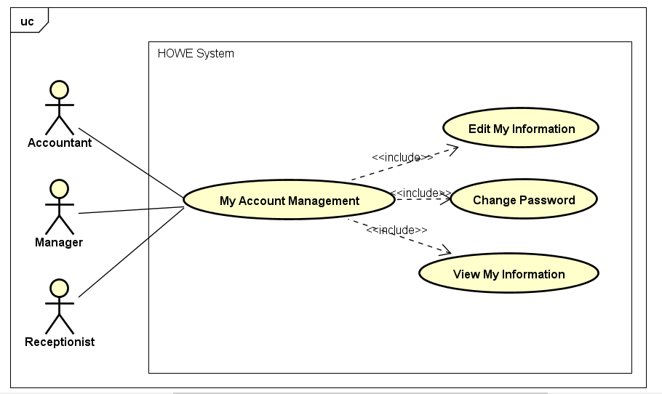

Software requirement specification
ソフトウェア要件仕様
Use Case Diagram
3 use cases
Common
Common use case diagram
17

Slide 19

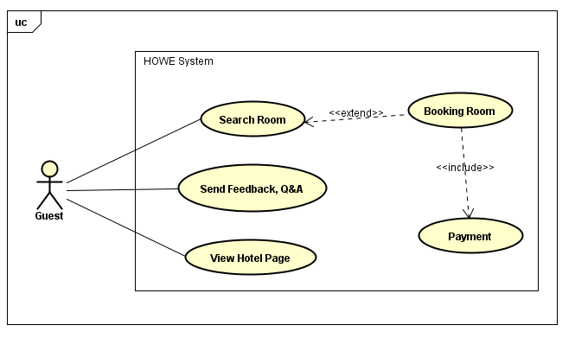
Software requirement specification
ソフトウェア要件仕様
Use Case Diagram
5 use cases
Guest
Guest use case diagram
18

Slide 20

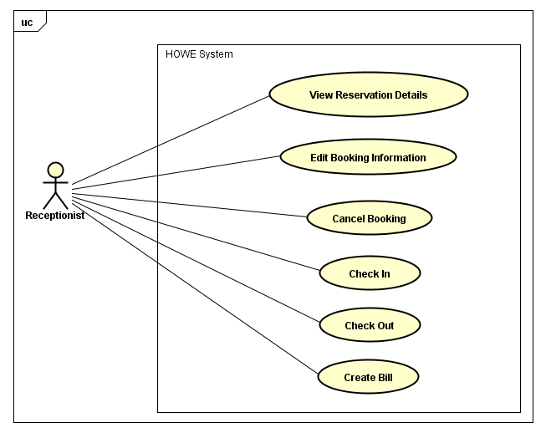
Software requirement specification
ソフトウェア要件仕様
Use Case Diagram
8 use cases
Receptionist
Receptionist use case diagram
19

Slide 21
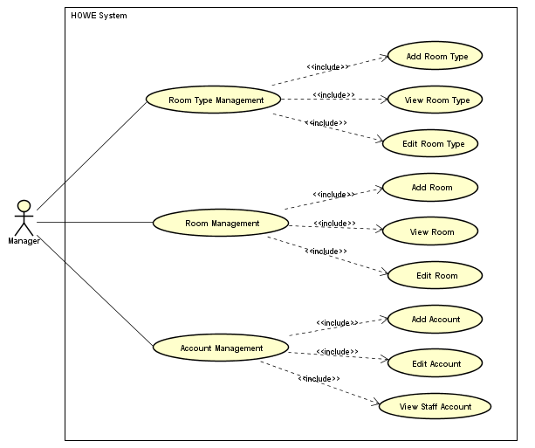
Software requirement specification
ソフトウェア要件仕様
Use Case Diagram
10 use cases
Manager
Manager use case diagram
20

Slide 22
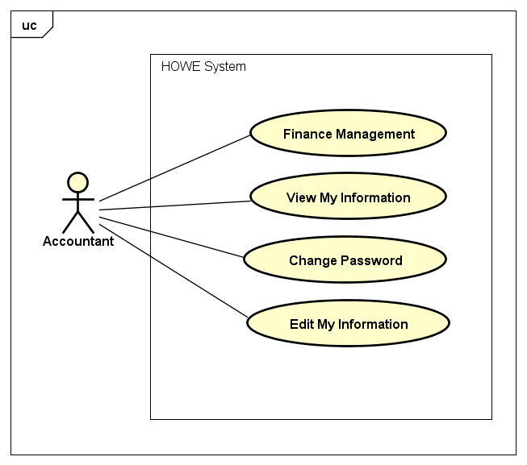
Software requirement specification
ソフトウェア要件仕様
Use Case Diagram
1 use case
Accountant
Accountant use case diagram
21

Slide 23

Software requirement specification
ソフトウェア要件仕様
Non – Functional Requirement
Usability
Interface should be beauty, simple, easy-to-use, clear.
The short, easy steps make it easy for actor to interact with the system immediately after training.
Provide an introduction to support users.
22

Slide 24


Software requirement specification
ソフトウェア要件仕様
Non – Functional Requirement
SUPPORTABILITY
Easy to maintain.
The website deployment and upgrade will be specified in the Installation Guide documents.
DESIGN CONSTRAINTS
Default date format: YYYY/MM/DD (example: 2017/05/29)
Default time format: HH(24):MM (example: 22:07)
Decimal places only 1-digit (example 2.2)
Decimal places of ‘%’ is 1-digit (example: 23.4%)
Currency: !#,#.00 (! is currency symbol, # is one or more digit)
23

Slide 25
SOFTWARE DESIGN DESCRIPTION
ソフトウェア 設計書
24

Slide 26
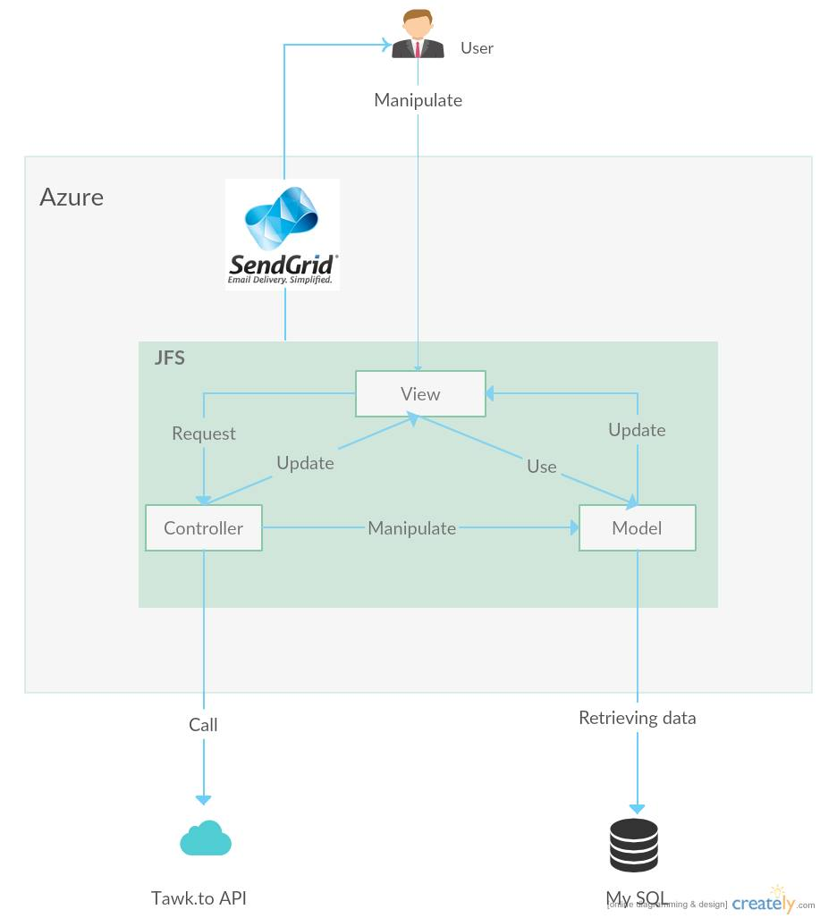
Software Requirement Specification
Architecture Overview
26

Slide 27
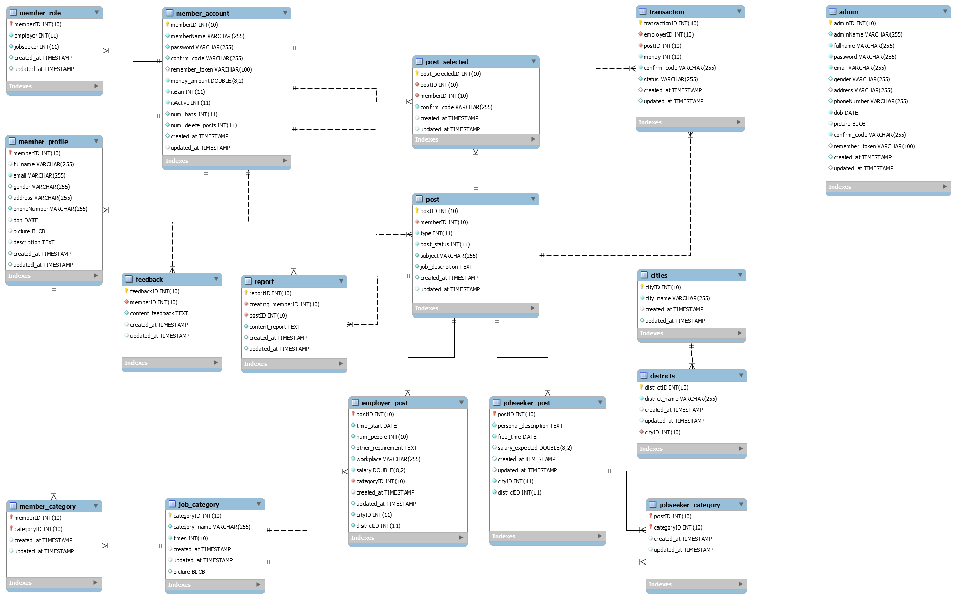
Software Requirement Specification
Database
Design
27

Slide 28
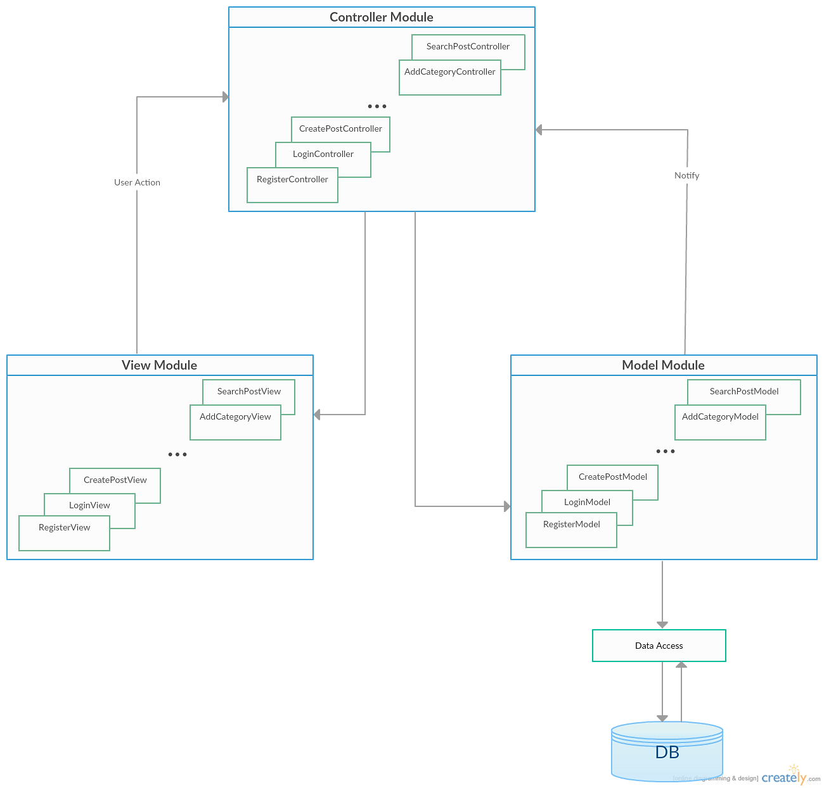
Software Requirement Specification
Component
Diagram
28

Slide 29
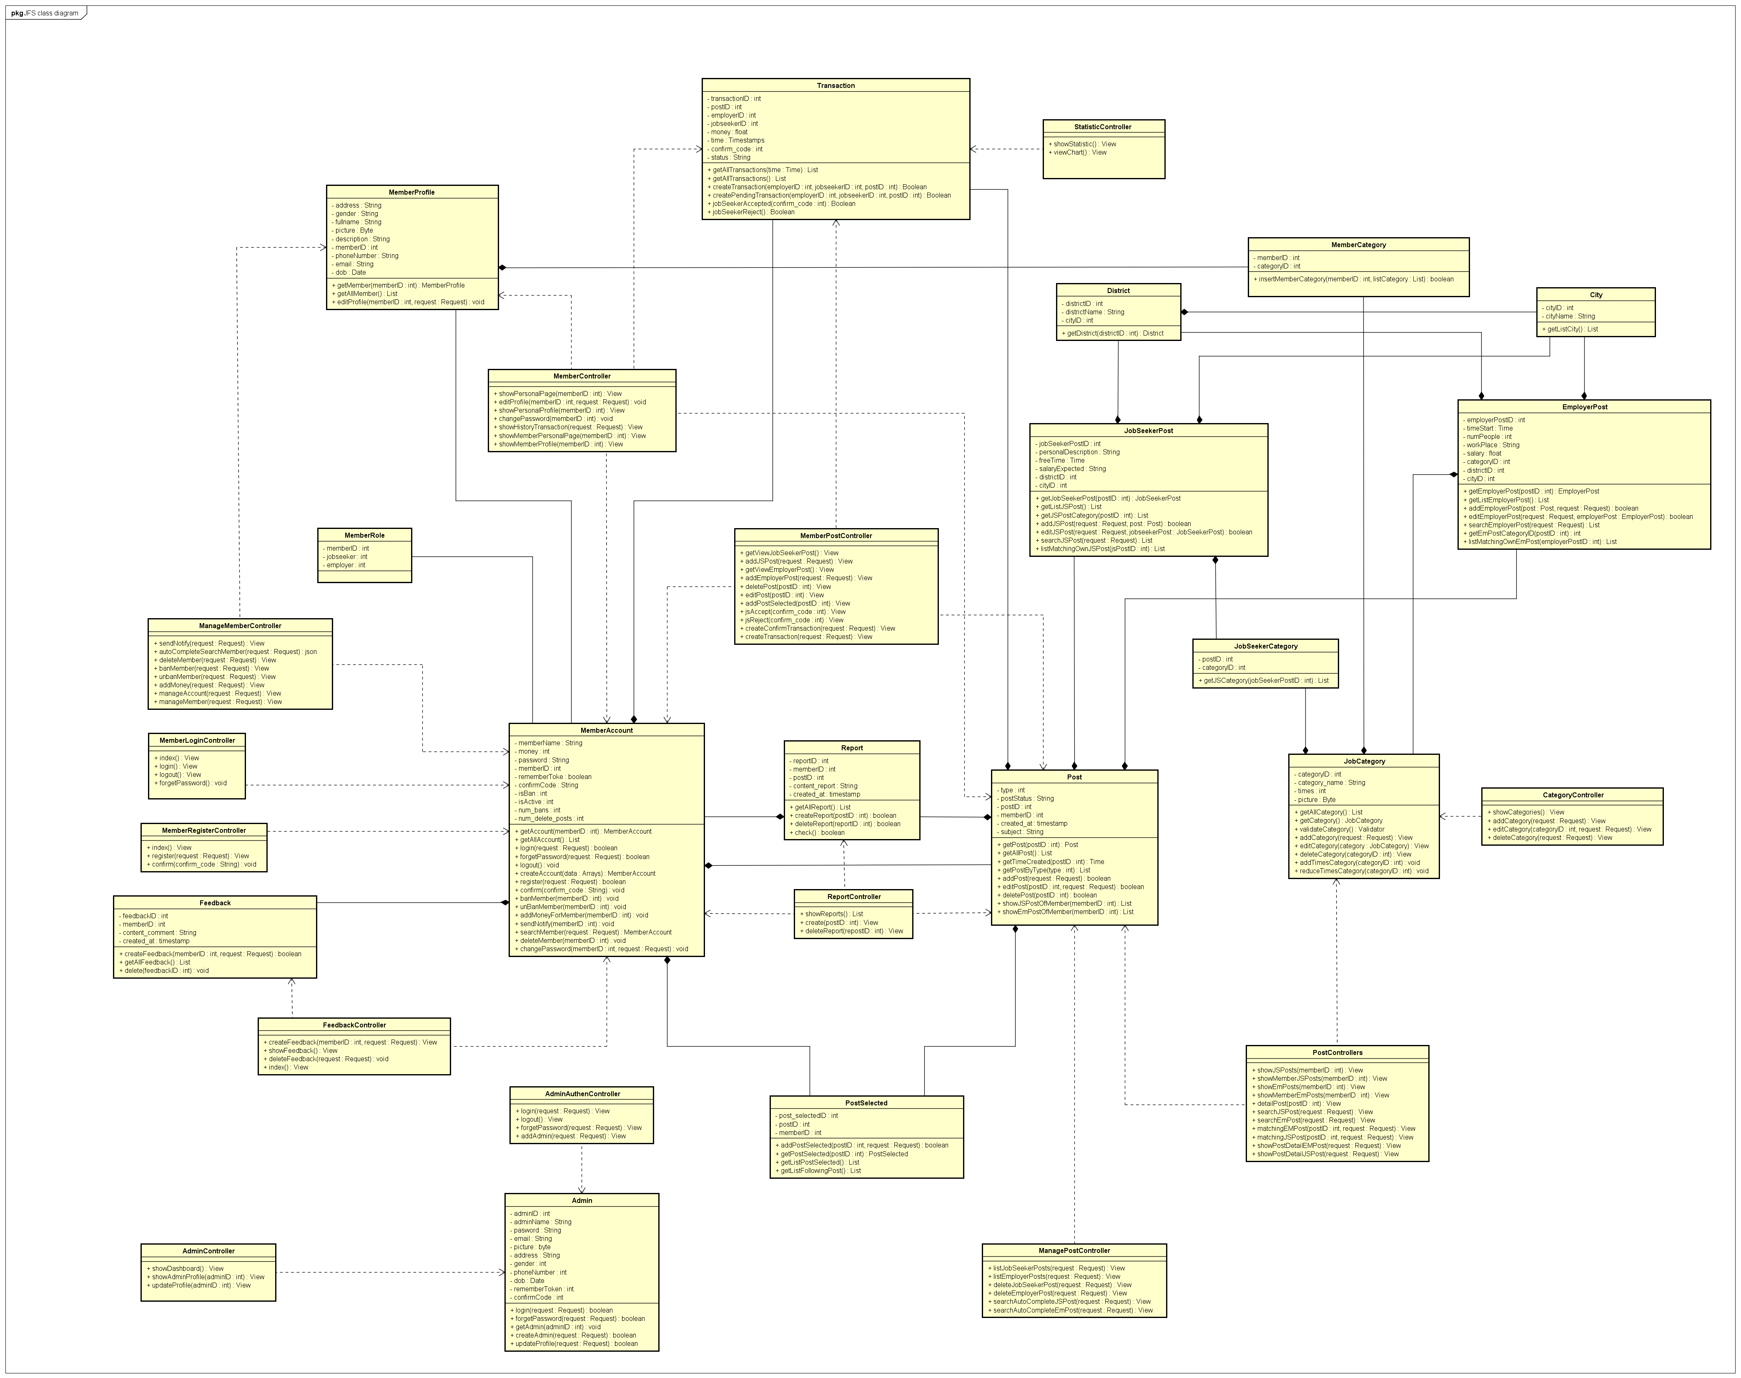
Software Requirement Specification
Class
Diagram
29

Slide 30
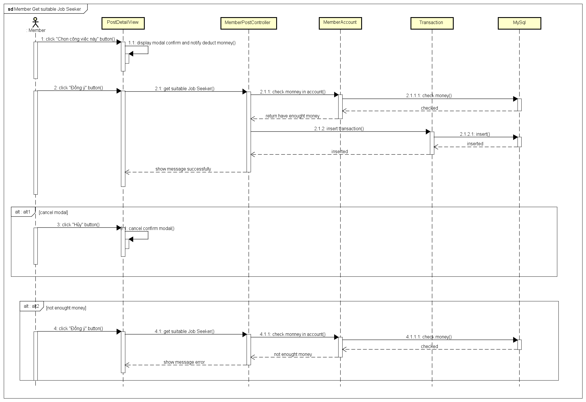
Software Requirement Specification
Sequence Diagram
Member Get Suitable Job Seeker
30

Slide 31



SOFTWARE TESTING
ソフトウェアテスト
31

Slide 32
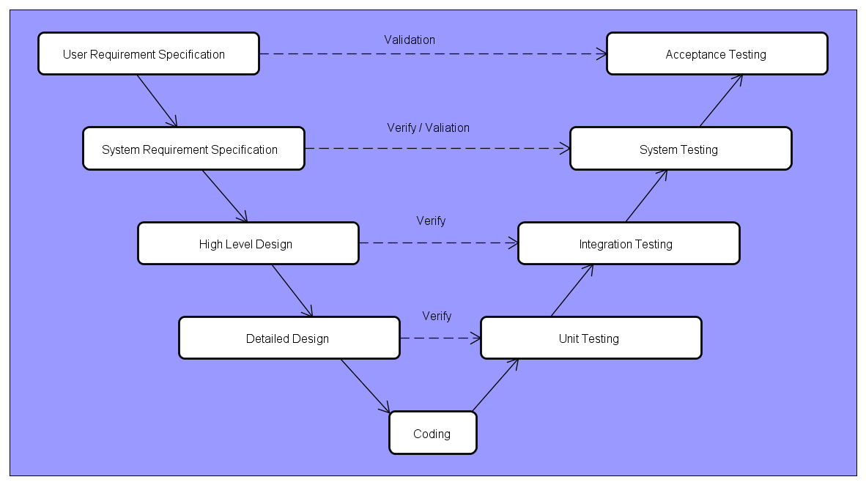
Testing
V-Model
32

Slide 33



Test Environment and Tool
Testing
Microsoft Windows 8.1 and Windows 10
Google Chrome 54.0
Mozilla Firefox 49.0.2
Microsoft Office Word, Excel 2010
Lean Testing (“leantesting.com”)
33

Slide 34
01
Testing
Create Test Plan
02
Create Test Case
03
Execute Test
04
PowerPointDep.net - website cung cấp các mẫu thiết kế hàng đầu về PowerPoint.
Log Bug
05
Re-test
06
Create Test Report
34

Slide 35
Testing
Create Test Plan
Base on Project Plan, Project Schedule, SRS to create Test Plan
Acceptance Test Criteria
Risks and contingencies
Features to be tested
Responsibilities
Environment
Schedules
….
35

Slide 36
Testing
Create Test Plan
Acceptance Test Criteria
Test coverage : 100%
Successful Test coverage : 90%
Number of defects/Weighted defects : 3~4
Defects/KLOC
Job Finding System : 4200 loc. Total of integration test : 528 test cases. Total of system test : 490 test cases.
36

Slide 37

Testing
Create Test Case
01
Create Test Case
Unit Test Case
02
Integration Test Case
03
System Test Case
37

Slide 38
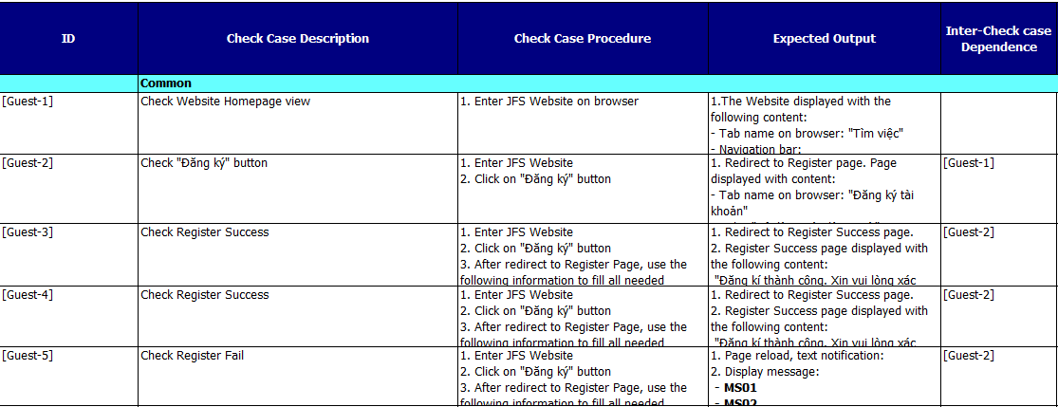
THIS IS A SLIDE TITLE
Testing
Integration Test Case
38

Slide 39
Testing
Execute Test
01
Developer :
Unit test case.
Tester :
Integration Test System Test.
02
39

Slide 40
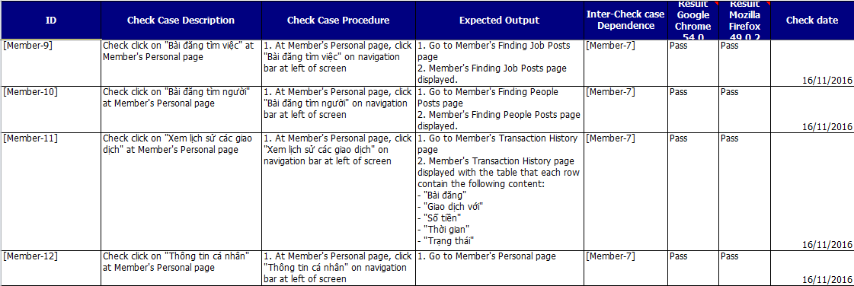
Testing
Execute Integration Test
40

Slide 41
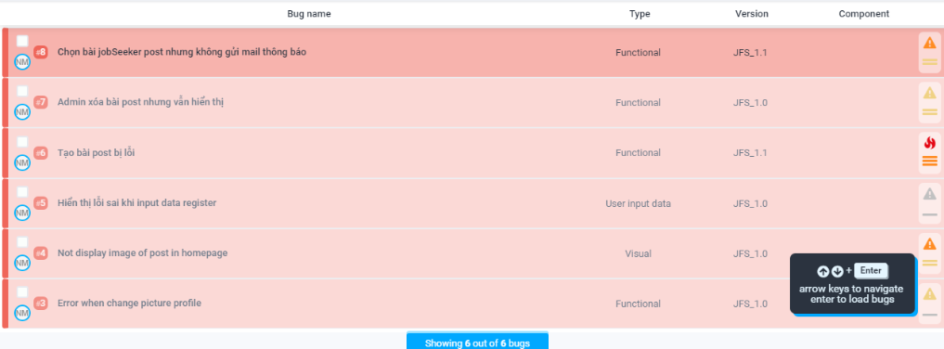
Testing
Log bug
41

Slide 42
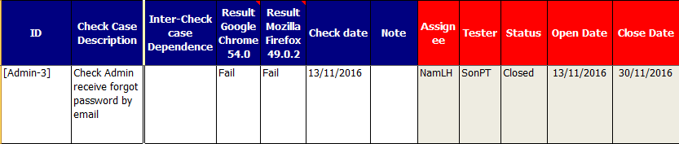
Testing
Re-Test
White
Is the color of milk and fresh snow, the color produced by the combination of all the colors of the visible spectrum.
After assigned developer fixed bug, tester re-test until bug is fixed successfully, and then change status of bug to Closed.
42

Slide 43
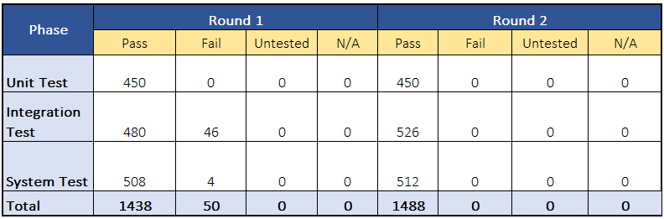
Testing
Create Test Report
Tester has responsibility to write test report for each test phase.
After finishing all testing phases, Test leader creates Final Test Report.
43

Slide 44
LESSON LEARNED
教訓
44

Slide 45




LESSON LEARNED
Teamwork
Management Skill
Business Analysis
New Technology
45

Slide 46
DEMO
デモ
46

Slide 47
Q&A
質問と回答
47

Slide 48

48

